Slide 1


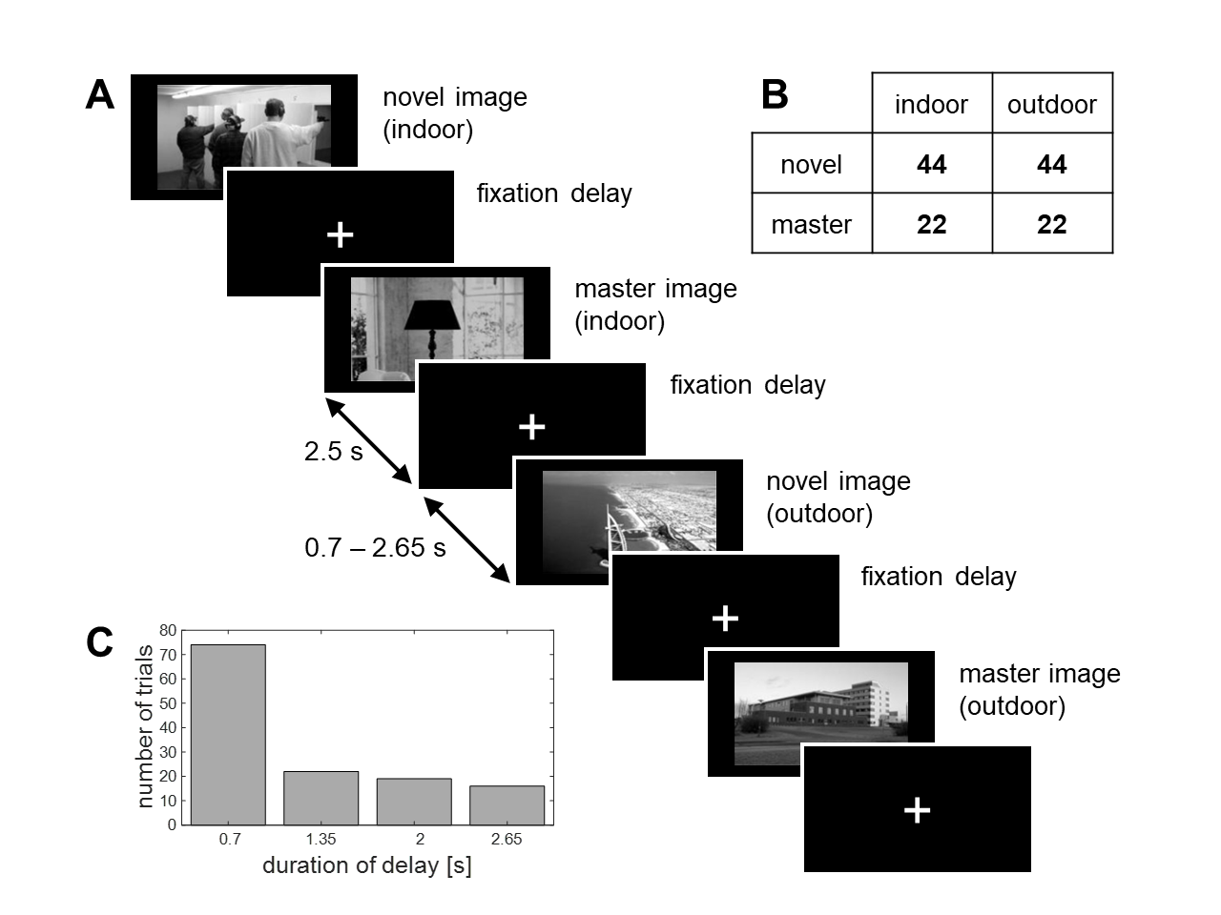
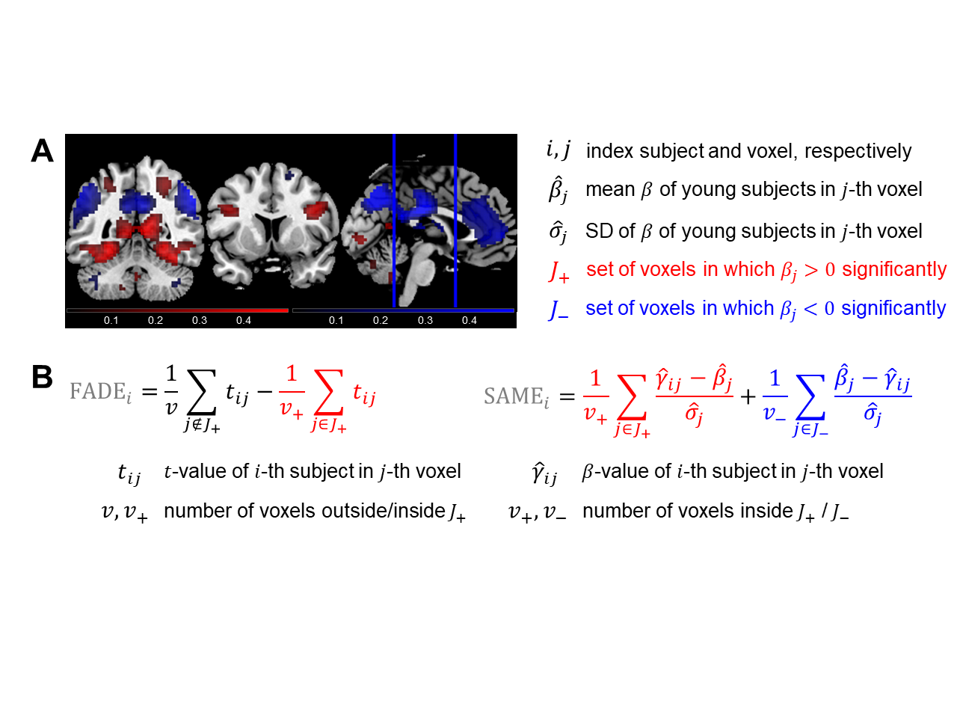
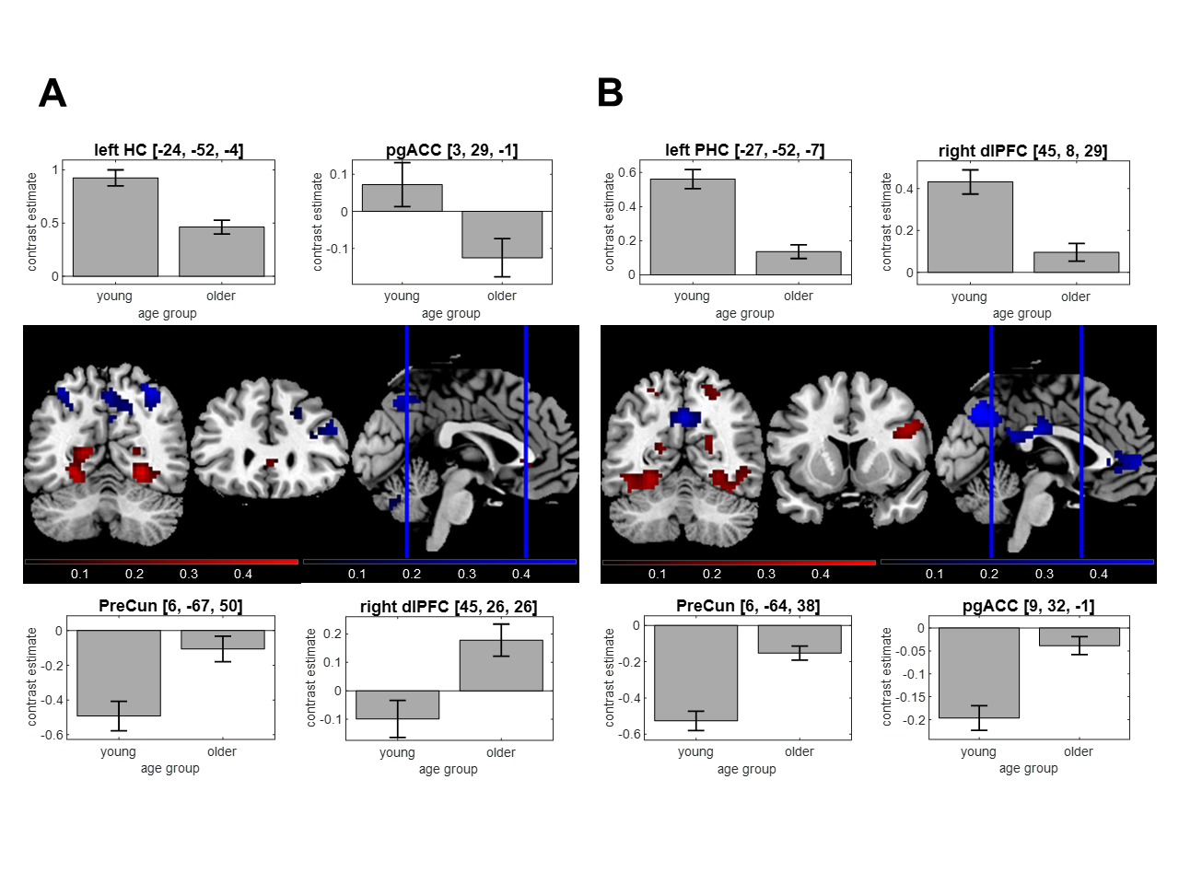
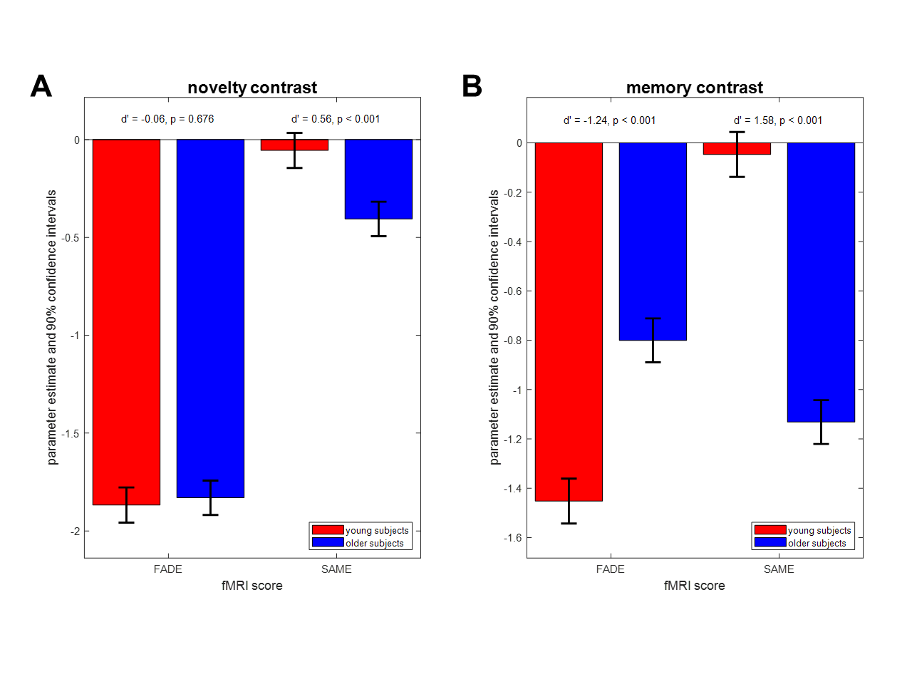
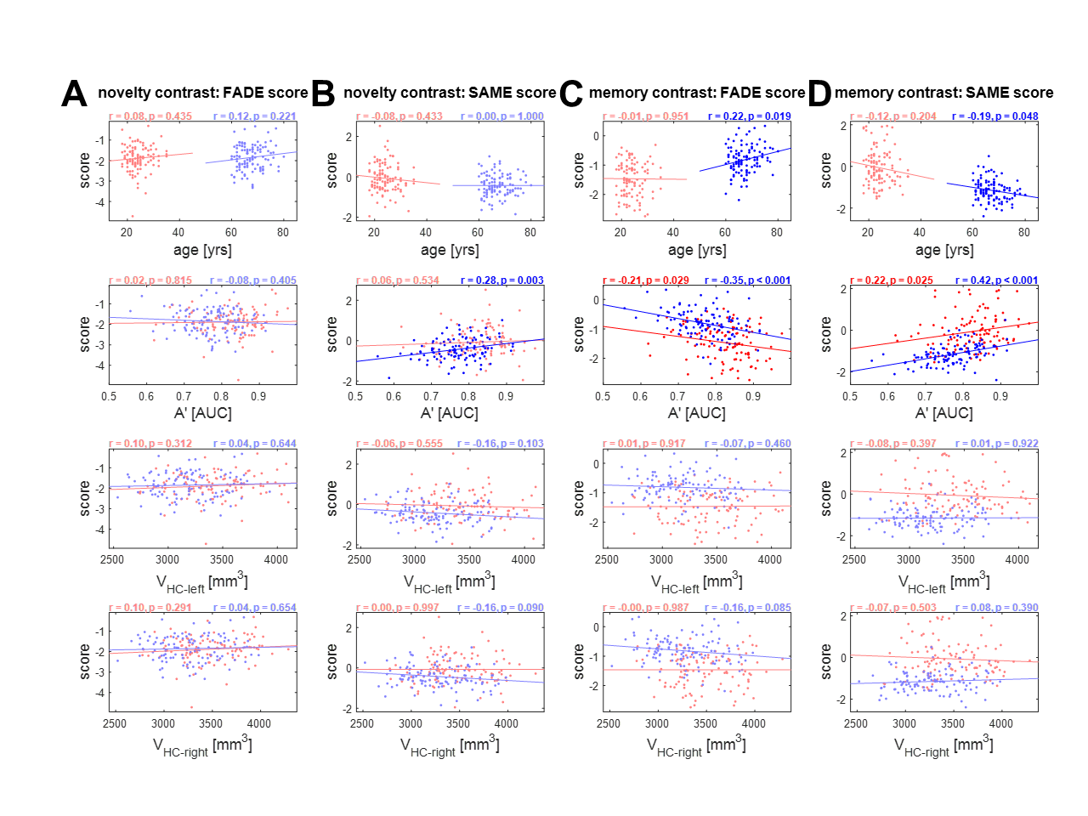
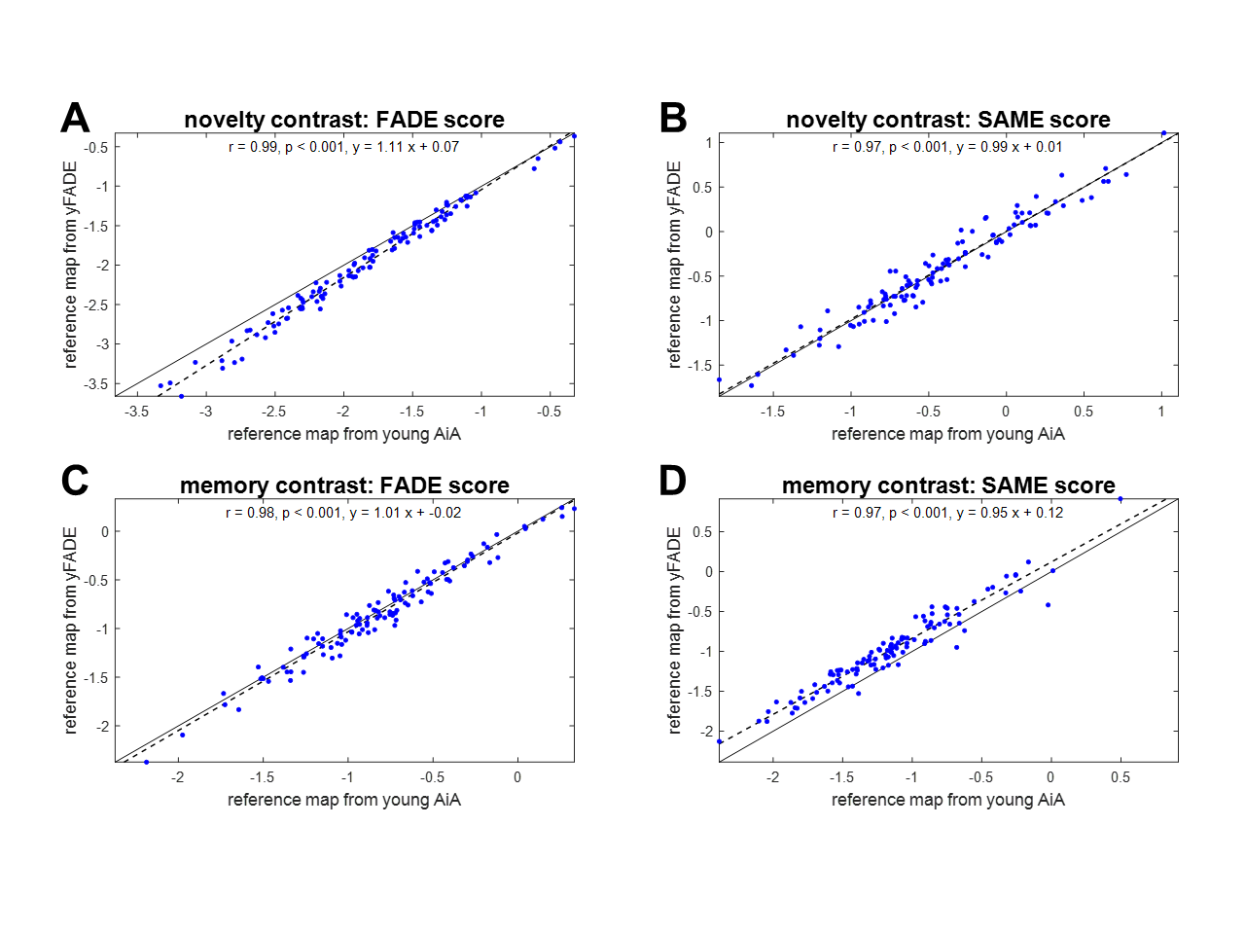
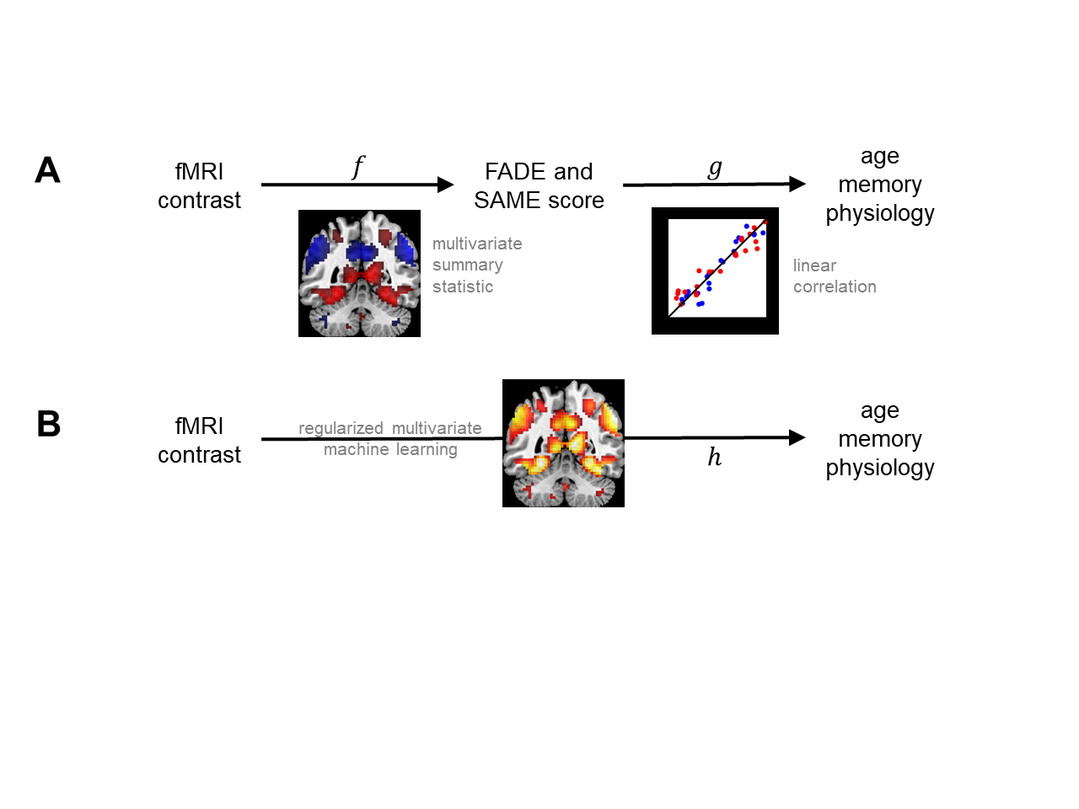
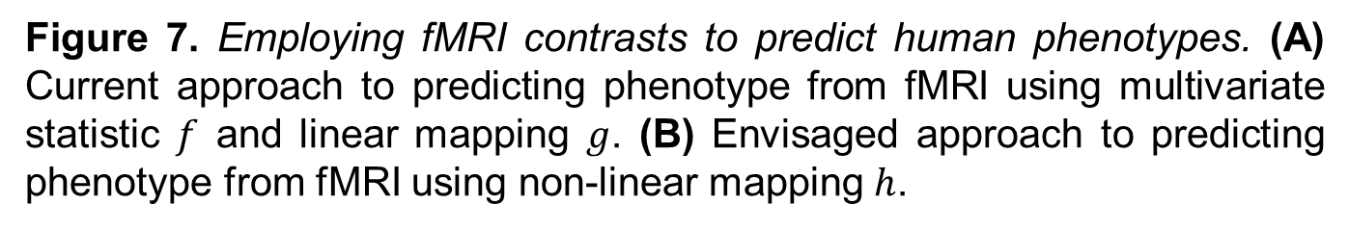
Memory-related fMRI activations and deactivations
as a potential biomarker for neurocognitive aging
Joram Soch*^{,1,2,●}, Anni Richter*^{,3}, Hartmut Schütze^{4,5}, Jasmin Kizilirmak¹, Björn Schott^{1,3,6,7,●}
¹ German Center for Neurodegenerative Diseases (DZNE), Göttingen, Germany
² Bernstein Center for Computational Neuroscience (BCCN), Berlin, Germany
³ Leibniz Institute for Neurobiology (LIN), Magdeburg, Germany
⁴ German Center for Neurodegenerative Diseases (DZNE), Magdeburg, Germany
⁵ Medical Faculty, Otto von Guericke University, Magdeburg, Germany
⁶ Center for Behavioral Brain Sciences (CBBS), Magdeburg, Germany
⁷ Department of Psychiatry and Psychotherapy, University Medical Center Göttingen
● Corresponding authors: Joram.Soch@DZNE.de, Bjoern.Schott@lin-magdeburg.de.
* These authors contributed equally to this work.
Abstract #2438
Poster #2438
Introduction
Older adults, particularly those at risk for developing dementia, typically show a decline in episodic memory performance, which has been associated with altered memory network activity detectable via functional magnetic resonance imaging (fMRI).
There are two ways of assessing such episodic memory networks: (i) as neural correlates of novelty processing by contrasting familiar with novel items or (ii) as neural correlates of subsequent memory by contrasting items remembered with items forgotten in a later memory test [1].
Both, novelty and subsequent memory, are charac-terized by significant activations of medial temporal lobe, prefrontal and parietal cortical structures, and by significant differences between healthy young and older adults in these areas [2].
In this study, we evaluated two reductionist scores derived from memory-related fMRI activations as potential biomarkers for successful aging in episodic memory and tested whether they are predictive with respect to age and memory performance.
Methods
We analyzed fMRI data from 106 young (18-35 yrs, 47/59 m/f) and 111 older (60-80 yrs, 46/65 m/f) subjects performing the so-called “FADE task” [1], a visual incidental episodic memory encoding task (see Figure 1). We then .
implemented two fMRI biomarkers (FADE = “functional activity deviation during encoding”; SAME = “similarities of activations during memory encoding”) [8] which quan-tify the deviation of a given older subject from activa-tions and deactivations of young subjects (see Figure 2).
Figure 1. Experimental design and stimulus timing during encoding. (A) Exemplary sequence of trials, each trial consisting of either a previously unseen novel image or a pre-familiarized master image showing either an indoor or an outdoor scene. (B) Number of trials in the four experimental conditions. (C) Distribution of ISIs in the encoding session.
Figure 2. Measures for quantifying successful aging in memory. (A) A reference map is obtained by significance testing of a contrast within the group of young subjects, resulting in voxels with significant activation (red) or significant deactivation (blue). (B) Scores of older subjects are calculated by averaging single-subject contrast outcomes within selected sets of voxels.
Results
Discussion
We found that
both scores significantly differ between young and older adults when computed from the memory contrast, and the FADE-SAME score also does so for the novelty contrast (see Figure 4);
when controlling for age group, both scores are correlated with memory performance when computed from the memory contrast, which also holds for the FADE-SAME score on the novelty contrast (see Figure 5);
both scores are equally stable when computed for older adults using different reference samples of young subjects (see Figure 6) and the FADE-SAME score is also stable when computed for young subjects acquired in different studies [8].
Taken together, we show that highly reductionist and easy-to-use fMRI scores reliably detect correlates of age-related alterations in human memory networks. The FADE-SAME score provides a comprehensive measure that accounts for both activations and de-activations as well as inter-individual variability in the baseline cohort of young subjects [8].
In future work, we want to evaluate FADE-classic and FADE-SAME scores for differentiating between clinical memory-impaired populations, e.g. different stages of Alzheimer’s disease [3].
Figure 3. Age-related differences in the memory network. (A) Significant effects of age on the novelty contrast, with reduced activations in hippocampus and pgACC and reduced deactivations in PreCun and dlPFC. (B) Significant effects of age on the memory contrast, with reduced activations in parahip-pocampal cortex and dlPFC and reduced deactivations in PreCun and pgACC.
Figure 4. Differences of FADE-classic and FADE-SAME score between age groups. Results from mixed ANOVAs with fMRI score and age group as factors. (A) The FADE-SAME score shows an age group difference on the memory contrast not found for the classic FADE score. (B) The classic FADE score and the FADE-SAME score show age group differences on the memory contrast.
Figure 5. Correlations with independent variables, separated by age group. Results from correlation analyses of FADE-classic and FADE-SAME scores with age (in years), memory performance (A’) and hippocampal volumes (V_{HC}). Young subjects are depicted in red, and older subjects are depicted in blue. Significant correlation coefficients are highlighted.
Figure 6. Stability of the FADE scores for older subjects as a function of reference sample. Comparison of scores computed for older subjects (older AiA), using reference maps obtained from either original young subjects (young AiA) or replication young subjects (yFADE). There are significant correlations for both scores and both contrasts.
Figure 7. Employing fMRI contrasts to predict human phenotypes. (A) Current approach to predicting phenotype from fMRI using multivariate statistic $f$ and linear mapping $g$. (B) Envisaged approach to predicting phenotype from fMRI using non-linear mapping $h$.
References
[1] Düzel E, Schütze H, Yonelinas AP, Heinze HJ. 2011. Functional phenotyping of successful aging in long-term memory: Preserved performance in the absence of neural compensation. Hippocampus 21:803–814. doi:10.1002/hipo.20834
[2] Maillet D, Rajah MN. 2014. Age-related differences in brain activity in the subsequent memory paradigm: A meta-analysis. Neurosci Biobehav Rev 45:246–257. doi:10.1016/j.neubiorev.2014.06.006
[3] Jessen F, Spottke A, [...], Wagner M, Düzel E. 2018. Design and first baseline data of the DZNE multicenter observational study on predementia Alzheimer’s disease (DELCODE). Alzheimer’s Res Ther 10:1–10. doi:10.1186/s13195-017-0314-2
[4] Düzel E, Acosta‐Cabronero J, [...], Zwanenburg J, Speck O. 2019. European Ultrahigh‐Field Imaging Network for Neurodegenerative Diseases (EUFIND). Alzheimer’s Dement Diagnosis, Assess Dis Monit 11:538–549. doi:10.1016/j.dadm.2019.04.010
[5] Assmann A*, Richter A*, [...], Seidenbecher CI, Schott BH. 2020. Neurocan genome‐wide psychiatric risk variant affects explicit memory performance and hippocampal function in healthy humans. Eur J Neurosci ejn.14872. doi:10.1111/ejn.14872
[6] Friston KJ, Holmes AP, Worsley KJ, Poline JP, Frith CD, Frackowiak RSJ. 1994. Statistical parametric maps in functional imaging: A general linear approach. Hum Brain Mapp 2:189–210. doi:10.1002/hbm.460020402
[7] Soch J*, Richter A*, [...], Düzel E, Schott BH. 2021. Bayesian model selection favors parametric over categorical fMRI subsequent memory models in young and older adults. NeuroImage. doi:10.1101/2020.07.27.220871
[8] Soch J*, Richter A*, [...], Düzel E, Schott BH. 2021. A comprehensive score reflecting memory-related fMRI activations and deactivations as potential biomarker for neurocognitive aging. bioRxiv. doi:10.1101/2021.01.16.426666

